Slide 1

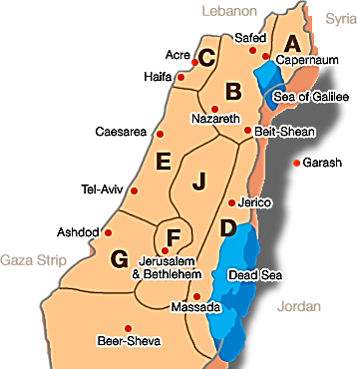
OMSPP – Usability and Applicability
Road Navigation (planning a trip or looking for a nearby gas station).
Robotics and Planning (multiple drones flying from a central dispatcher).
Army Needs (ballistic trajectory on multiple targets).

Slide 2
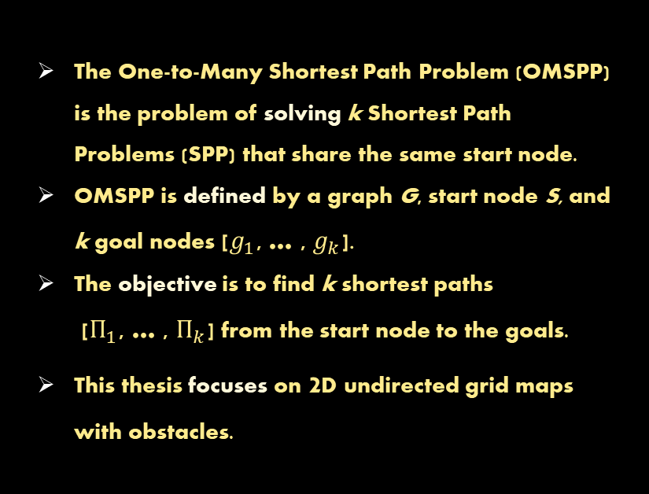
OMSPP - Definition
The One-to-Many Shortest Path Problem (OMSPP) is the problem of solving k Shortest Path Problems (SPP) that share the same start node.
OMSPP is defined by a graph G, start node S, and k goal nodes [$g_{1}$, … , $g_{k}$].
The objective is to find k shortest paths [$П_{1}$, … , $П_{k}$] from the start node to the goals.
This thesis focuses on 2D undirected grid maps with obstacles.

Slide 3



Existing Solution
G1
G2
There are three main families of existing solutions:
Uninformed Search (no heuristics).
Iterative Search (search for one goal at a time).
Aggregative Search (simultaneous search for all goals).
G3
S

Slide 4
Uninformed Search: k-UCS
Breadth search without a heuristic guideline.
Effective in cases:
(1) there is no heuristics. (2) the heuristics is expensive.
(3) many scattered goals.
Poor in cases with a relatively small number of goals and good heuristics.

Slide 5
Iterative Search: kxA*
Iterative k ordinary A* searches (each search for each goal).
Effective in cases with a small number of scattered goals.
The searches are independent (no information is shared between them).
Poor in cases with clustered goals.

Slide 6
Aggregative Search: kA*
Unified simultaneous search for all goals by using an aggregative heuristic.
For each generated node, an aggregative heuristic is calculated in two steps: (1) build a k-size vector of heuristics from the node to each active goal. (2) select the minimum value of the vector.
Effective in cases with clustered goals.
Poor in cases with scattered goals.

Slide 7
Existing Solutions - Decision Matrix
Suitable OMSPP algorithm depends on: (1) Goal Quantity. (2) Goal Distribution.
kA* is preferable for OMSPP with clustered goals.
OMSPP with clustered goals are more common in human applications.

Slide 8
OMSPP - New Solutions
Forward
G1
Three new efficient algorithms for OMSPP: (1) Forward-Sequential-kA* (FS-kA*). (2) Backward-Sequential-kA* (BS-kA*). (3) Forward-Backward-Sequential-kA* (FBS-kA*).
New algorithms are classified as iterative searches.
Ability to share information between the sub-searches.
Differ in their search direction.
Start
G2
Backward
G1
Start
G2
Forward
Backward
G1
Start
G2

Slide 9
Forward-Sequential-kA* (FS-kA*)
FS-kA* is actually a hybrid of kxA* and kA* algorithms.
FS-kA* combines the iterability of kxA* with the shared data structures of kA*.
FS-kA* outperforms the kxA* and kA* in: (1) expanded nodes. (2) heuristic calculations.
kxA*
kA*
Iterability
Shared Data Structures
Independent Data Structures
Aggregative Heuristics
FS-kA*

Slide 10
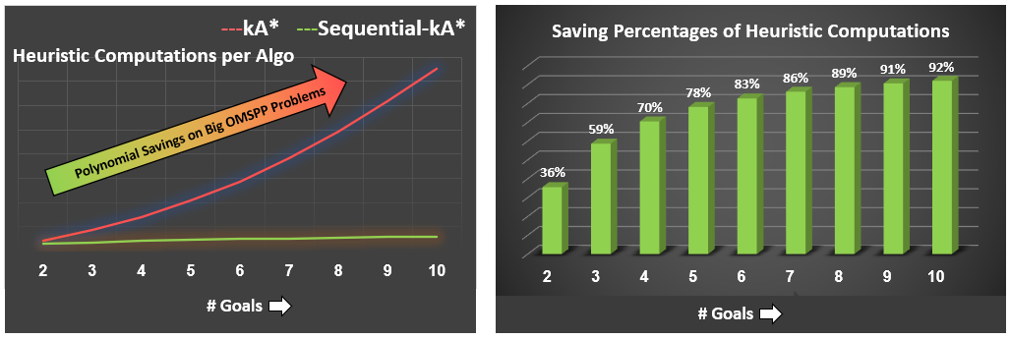
Forward-Sequential-kA* (FS-kA*)
FS-kA* has a slight advantage over the kA* in the expanded nodes.
Its significant advantage is the polynomial savings in a number of heuristic calculations.
As the number of goals increases, the heuristic savings become more significant.
FS-kA*

Slide 11
Backward-Sequential-kA* (BS-kA*)
BS-kA* is actually: (1) a transformation of kxA*, when we reverse the search direction. (2) and an enhancement with the ability to share information between the sub-searches.
kxA*
G1
S
G2
Reverse Search Direction
BS-kA*
Shared Lookup Table
Add Feature
G1
S
G2

Slide 12
Backward-Sequential-kA* (BS-kA*)
BS-kA* shares between the sub-searches the optimal paths of the previous sub-searches:
(1) allows the sub-search to know exact distances from the start. (2) directs the search towards the start node. (3) terminates the search when expands a node from a lookup table.
Closed [G1]
S
Optimal Path [G1]
G1
Optimal Path [G2]
Closed [G2]
G2

Slide 13
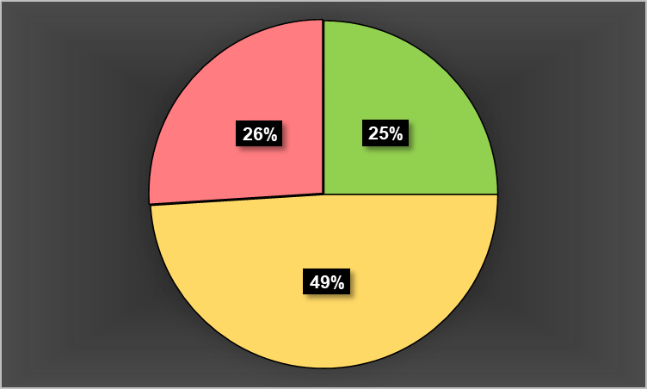
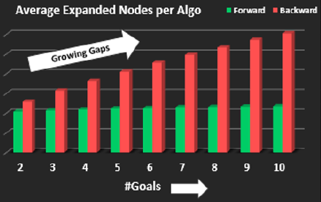
Backward-Sequential-kA* (BS-kA*)
BS-kA* is superior to FS-kA* when backward heuristics are more effective than forward.
Asymmetric characteristics of the obstacles and nodes locations (ex: the edge effect).
Direction Search Asymmetry
Backward
Forward
Equals

Slide 14
Backward-Sequential-kA* (BS-kA*)
Direction Search Asymmetry (SPP)
The BS-kA* is competitive with the FS-kA* in cases with a small number of goals.
In worst-case scenarios, the BS-kA* can expand the same node k times, while the FS-kA* never expands the node more than once.
This feature gives FS-KA* a decisive advantage in cases with many goals.
SPP
OMSPP
Backward
Forward
Equals

Slide 15
Forward-Backward-Sequential-kA* (FBS-kA*)
FBS-kA* is a combination of forward and backward searches: (1) the search begins with a forward search for the nearest goal. (2) then the BS-kA* is executed, enhanced by the information obtained from the forward search.
Closed [G1]
G1
S
Closed [G3]
Closed [G2]
G3
G2

Slide 16
Forward-Backward-Sequential-kA* (FBS-kA*)
In FBS-kA*, the forward search contains more information to share than the backward searches.
Each node in the forward CLOSED list contains the optimal path to the start.
The backward sub-search is terminated when it expands a node from a lookup table.
Closed [G1]
G1
S
Closed [G3]
Closed [G2]
G3
G2

Slide 17
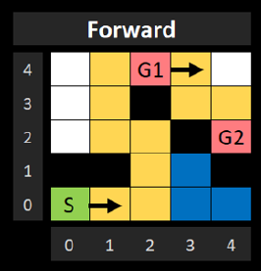
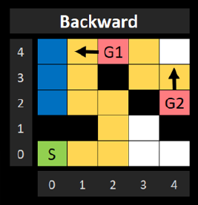
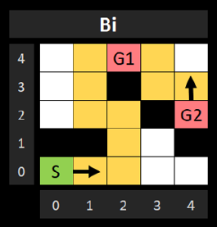
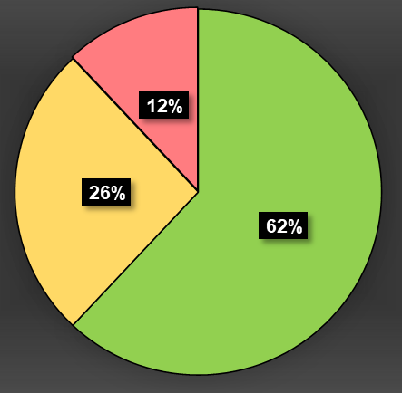
Forward-Backward-Sequential-kA* (FBS-kA*)
In most cases the FS-kA* and BS-kA* outperform the FBS-kA*.
FBS-kA* performance is usually intermediate between the two.
FBS-kA* is useful in risk-averse situations where avoiding risks of poor performance is the primary concern (resource limitations).
Sample of FBS-kA* superiority
FS-kA*
BS-kA*
FBS-kA*
Statistical distribution of wins between the algorithms
FBS-kA*
BS-kA*
FS-kA*

Slide 18
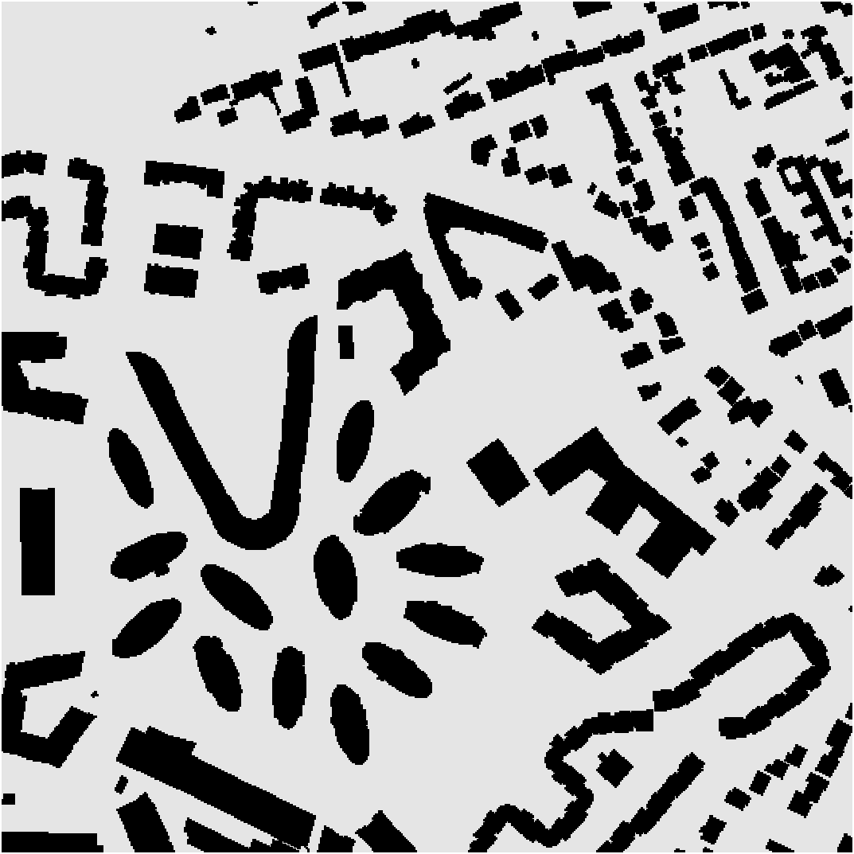
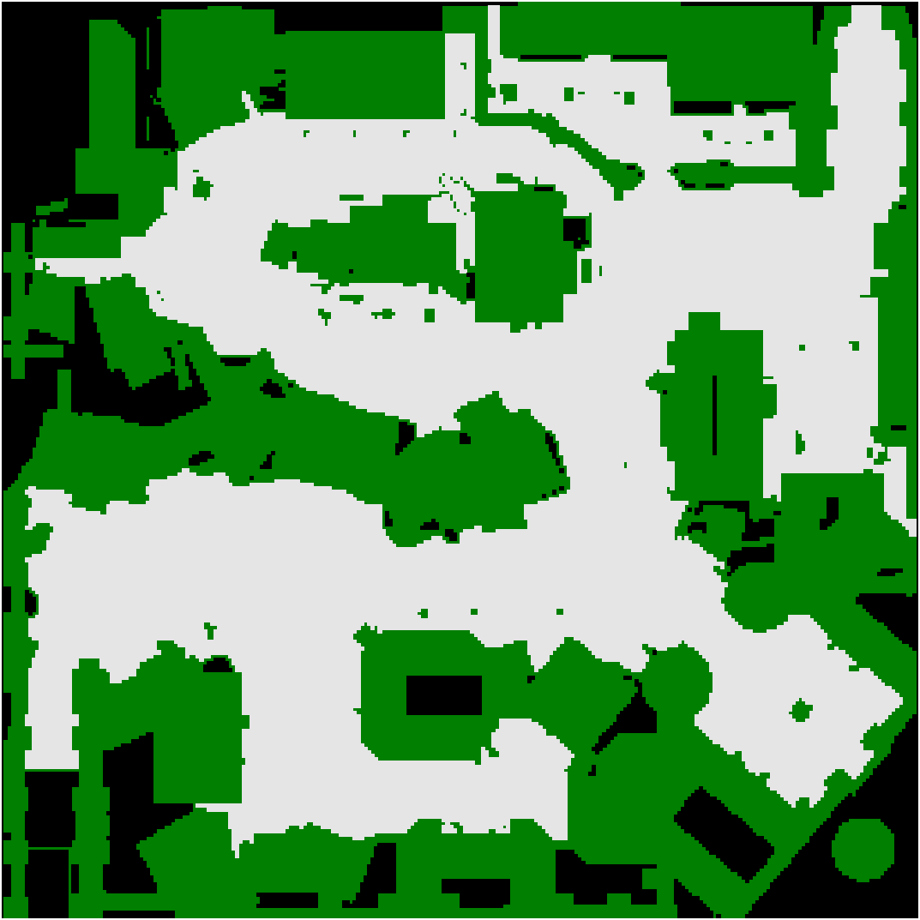
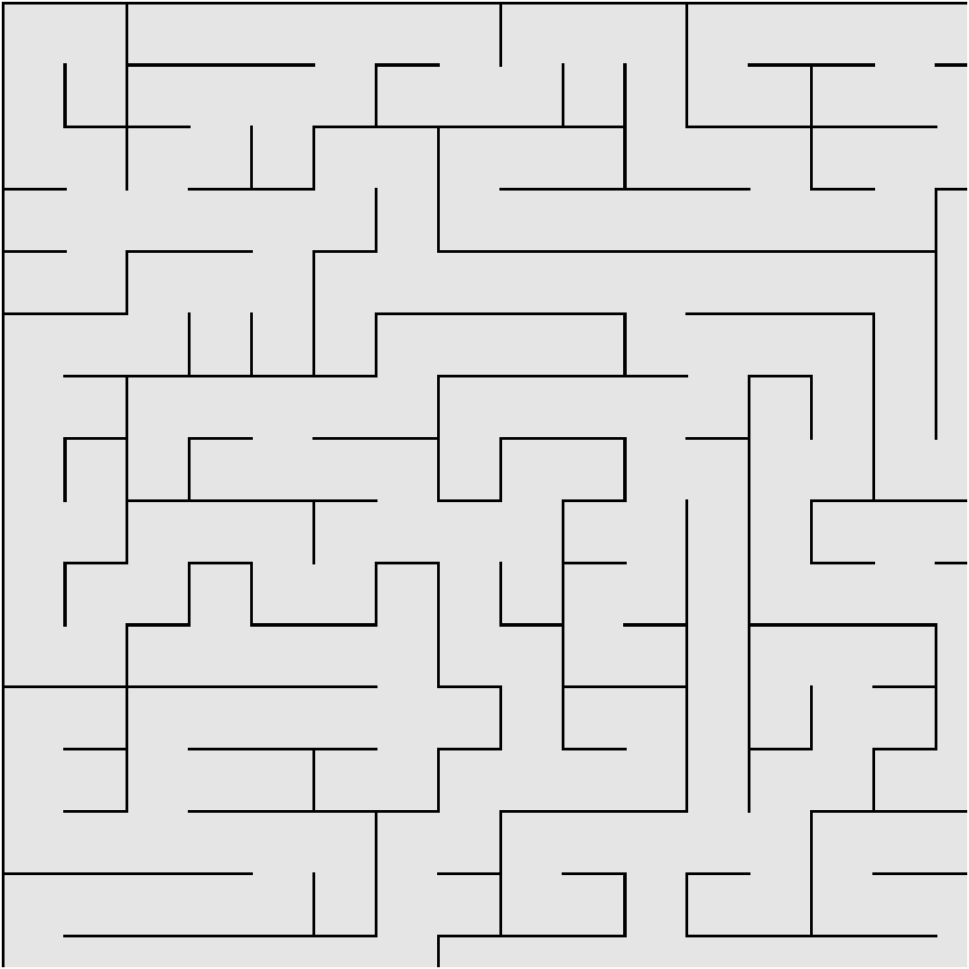
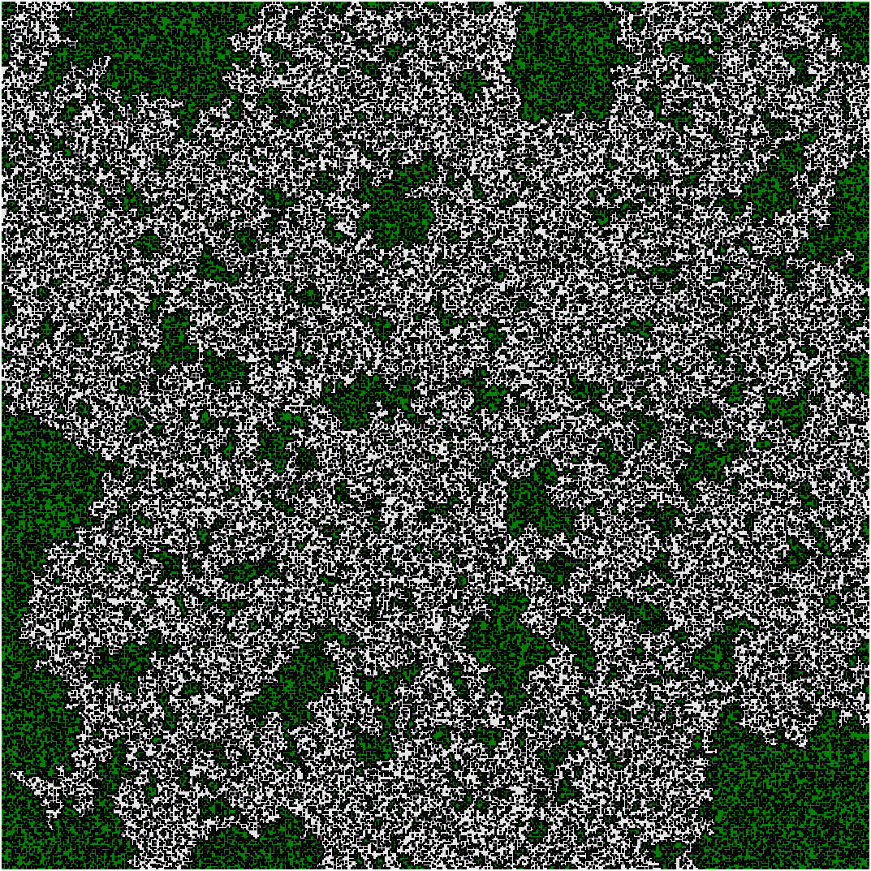
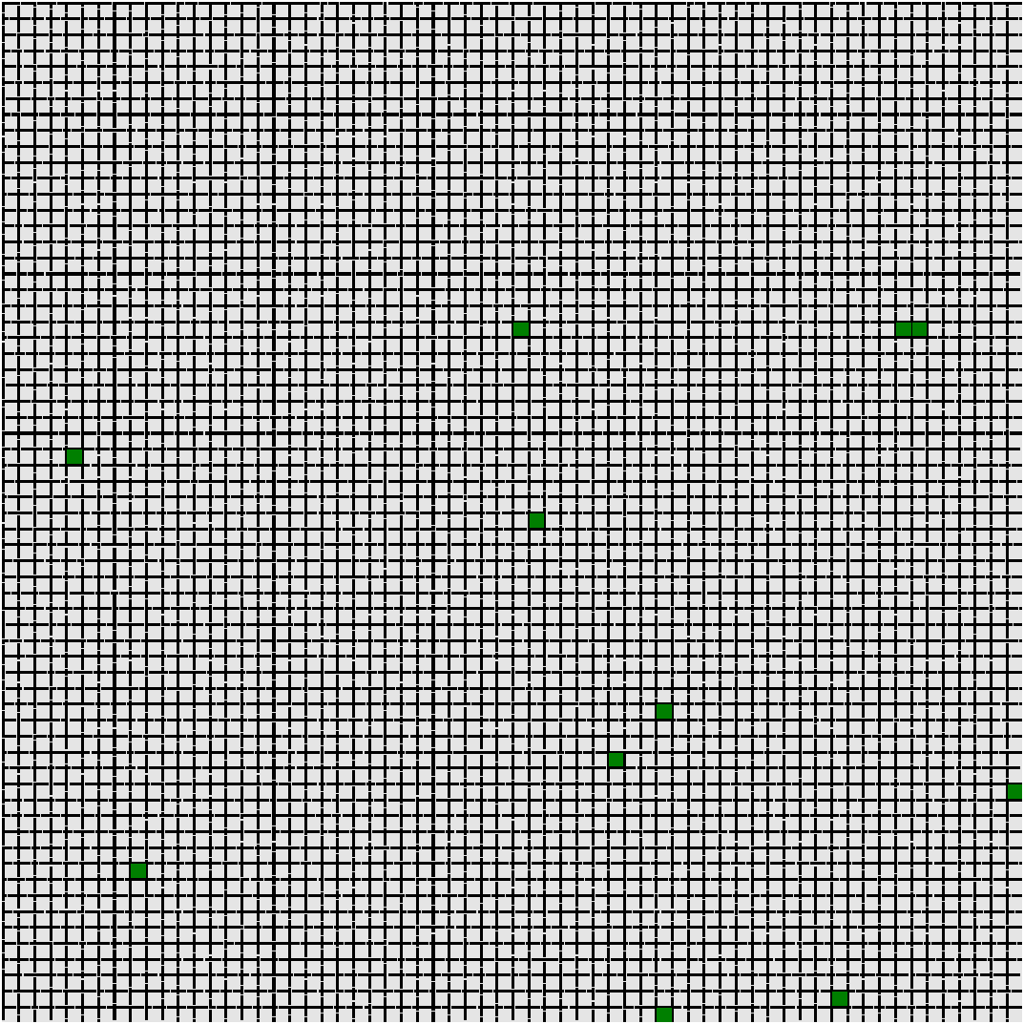
Experimental Design
We used maps from the popular grid-based path-finding benchmark to ensure that our research is based on real and varied OMSPPs.
The maps are categorized into five main domains (cities, games, mazes, random, and rooms).
We selected ten of the largest and most diverse maps for each domain.
Cities
Games
Mazes
Random
Rooms

Slide 19
Experimental Design
We conducted experiments on 20k~ different configurations of maps and node locations: (1) Number of goals. (2) Distances between the nodes. (3) Random node locations.
Cities
Games
Mazes
Random
Rooms

Slide 20
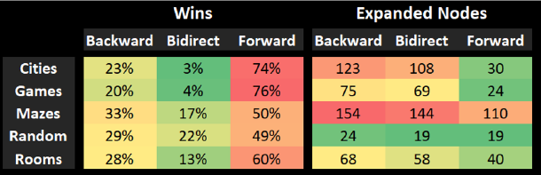
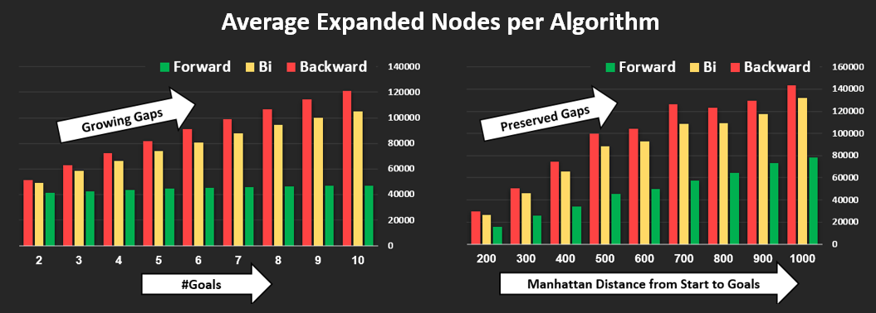
Experimental Results
Top Insights:
The FS-kA* performs best in the domains of cities and games (open areas).
The number of goals has a marginal effect on the forward search but significantly impacts the BS-kA* and FBS-kA* searches.
The relevance of BS-kA* and FBS-kA* decreases as the number of goals increases.
Distribution by algorithms and domains
BS-kA*
FBS-kA*
FS-kA*
BS-kA*
FBS-kA*
FS-kA*

Slide 21

The Oracle
Each OMSPP has a preferred direction search.
There is no deterministic algorithm that can predict the best search direction for a given map and node location.
To evaluate the potential, we built a simulation - the Oracle algorithm.

Slide 22
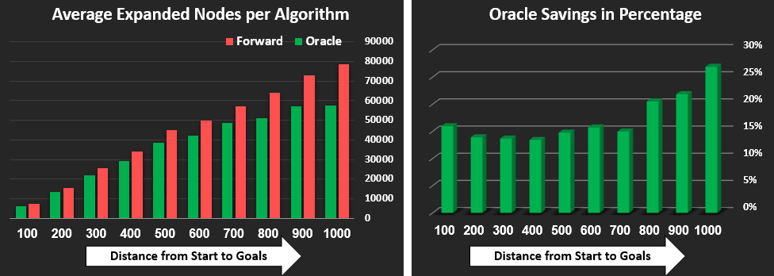
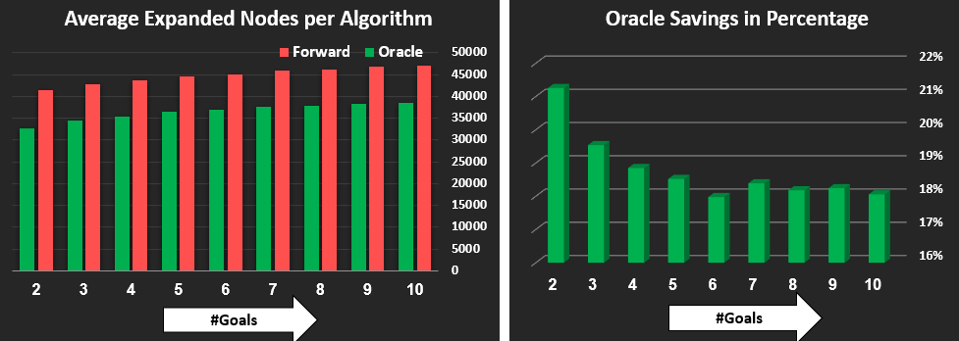
The Oracle - Results
Oracle vs FS-kA* by distances from start to goals
The Oracle algorithm can reduce about 20% of expanded nodes compared to FS-kA* (the baseline).
High correlation between Oracle's performance and the distance from the start to the goals (edge cases).
Negative correlation between the number of goals and Oracle performance (FS-kA* superiority).
The simulation provided interesting insights:
Oracle vs FS-kA* by number of goals

Slide 23
Machine Learning Approach
Train Set
Features
Expanded
OMSPP Algorithm
FS-kA*
BS-kA*
FBS-kA*
OMSPP
Training
Nodes
Test Set
OMSPP
Features
Model
Predicted Expanded Nodes

Slide 24
Machine Learning Approach
OMSPP
Linear Regression
Random Forest
XGBoost
ANN
Features
Model FS-kA*
Model BS-kA*
Model FBS-kA*
Predicted Expanded Nodes
Predicted Expanded Nodes
Predicted Expanded Nodes
ArgMin
Best Predicted Algorithm

Slide 25
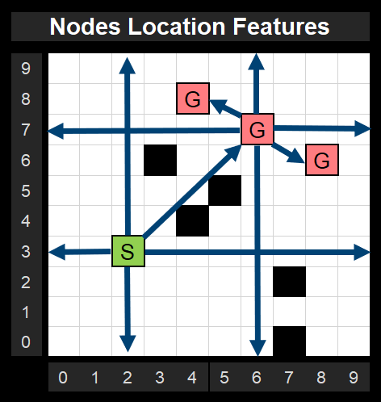
Machine Learning Approach - Features
Domain and Map features (domain-name, map-name, number of rows and cols in the map, number of nodes in the map).
Goals features (number of goals, distance from the start node, degree of dispersion).
Node Locations features (relative distances from the map's borders).
OMSP features can be divided into three categories:

Slide 26
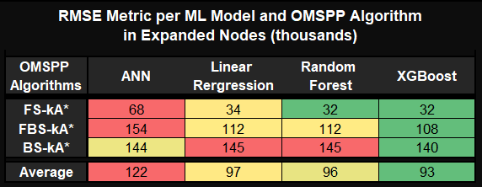
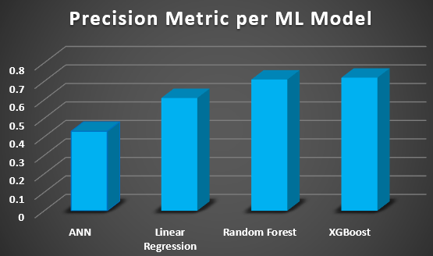
Machine Learning Approach - Results
XGBoost exhibits the best learning performance (the lowest RMSE).
There is a high correlation between the RMSE and Precision metrics
Top Insights:

Slide 27
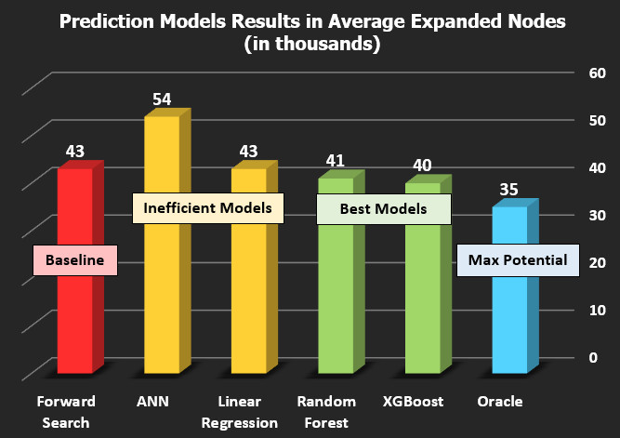
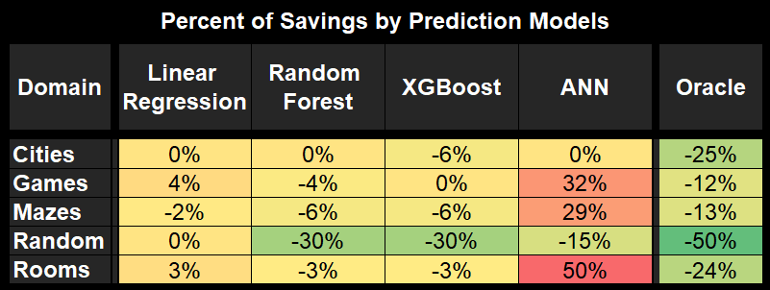
Machine Learning Approach - Results
ML models reduce on average, about 7% of the expanded nodes compared to the baseline (FS-kA*).
The maximum potential is to reduce additional 12% of expanded nodes (to reach the Oracle).
The models best learn the domain of the random maps.
Top Insights:

Slide 28
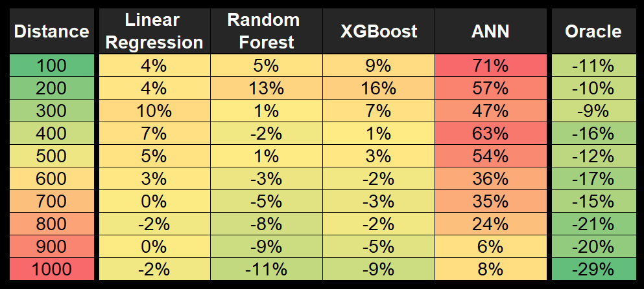
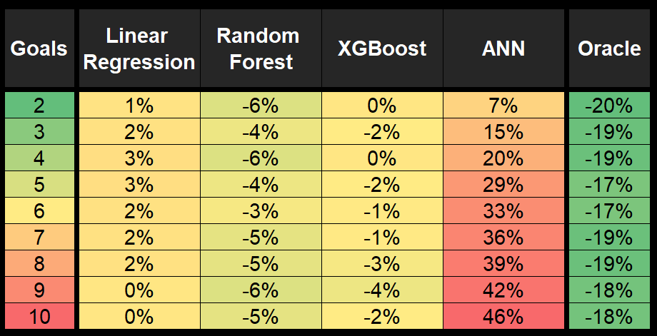
Machine Learning Approach - Results
The ML models predict OMSPP pretty well with short and long distances between the start and the goals (edge cases).
There is no clear correlation between the number of goals and model predictivity.
Models Performance by Distance
Top Insights:
Models Performance by Goals

Slide 29

Further Research
Domain Focus (rooms).
Additional domains (3d, puzzles).
Regrettable Model.
Resource prediction.
FS-kA*
BFS-kA*
BS-kA*

Slide 30
Thank You!

Slide 31
Improving Backward Search

Slide 32
Backward Search – Until Now
G1
S1
S
Conversion
G
G2
S2

Slide 33
Search Optimal-Path [S2]
P is on Optimal-Path [S1]
On P generation: (*) h*(P) = d(P,G)
On P exploration: (*) P is on Optimal-Path [S2] (*) f*(P) = f(G) (*) early termination
If f(P) < f(G) < f*(P): (*) prune unnecessary expansion
S1
h*(P) = d(P,G)
P
G
S2

Slide 34
Proposed Improvement
if A is adjacent node to P: (*) d(A,P) = 1 (*) h*(A) >= d(P,G)-1 [triangle inequality] (*) h*(A) = max[h(A), d(P,G)-1] [lower bound] (*) h*(A) >= h(A) (*) f*(A) >= f(A)
if f(A) < f(G) < f*(A): (*) prune unnecessary expansion
S1
h*(P) = d(P,G)
P
G
1
A
1 <= h(A) <= d(A,G)
h*(A) = max[h(A), d(P,G)-1] d(P,G)-1 is a lower bound
S2

Slide 35
Examples

Slide 36
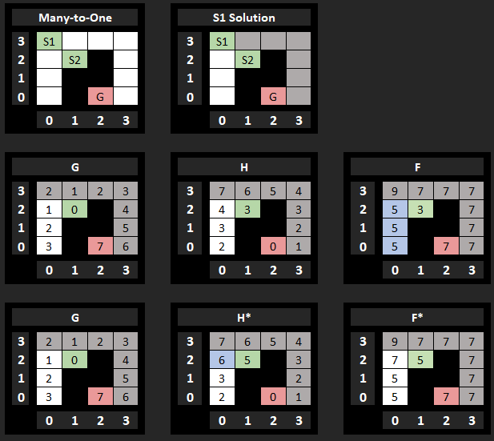
Grid Positive Example:
S2

Slide 37
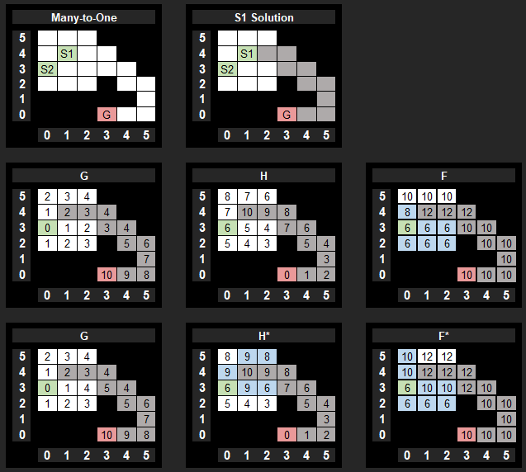
Grid Negative Example:
S2

Slide 38
Experiments

Slide 39
Experimental Design
We used maps from the popular grid-based path-finding benchmark to ensure that our research is based on real and varied OMSPPs.
The maps are categorized into five main domains (cities, games, mazes, random, and rooms).
We selected five of the largest and most diverse maps for each domain.
Cities
Games
Mazes
Random
Rooms

Slide 40
Experimental Design
We conducted experiments on 1250 different configurations of maps and node locations: (1) Number of goals (2, 4, 6, 8, 10). (2) Distances between the nodes. (3) Random node locations.
Cities
Games
Mazes
Random
Rooms

Slide 41
Experiments Results

Slide 42
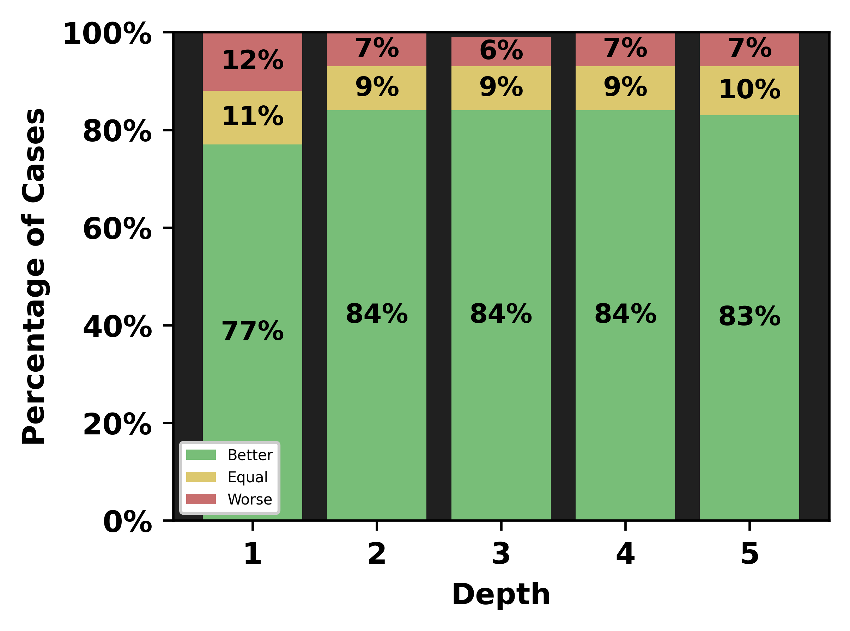
Performance Comparison by Depth
Depth 1: Reduced explored nodes in 77% of cases.
Depth 2: Added 7% more improved cases.
Depth > 2: No significant change.
Conclusion: Depth 2 appears to be the most effective depth for deepening.

Slide 43
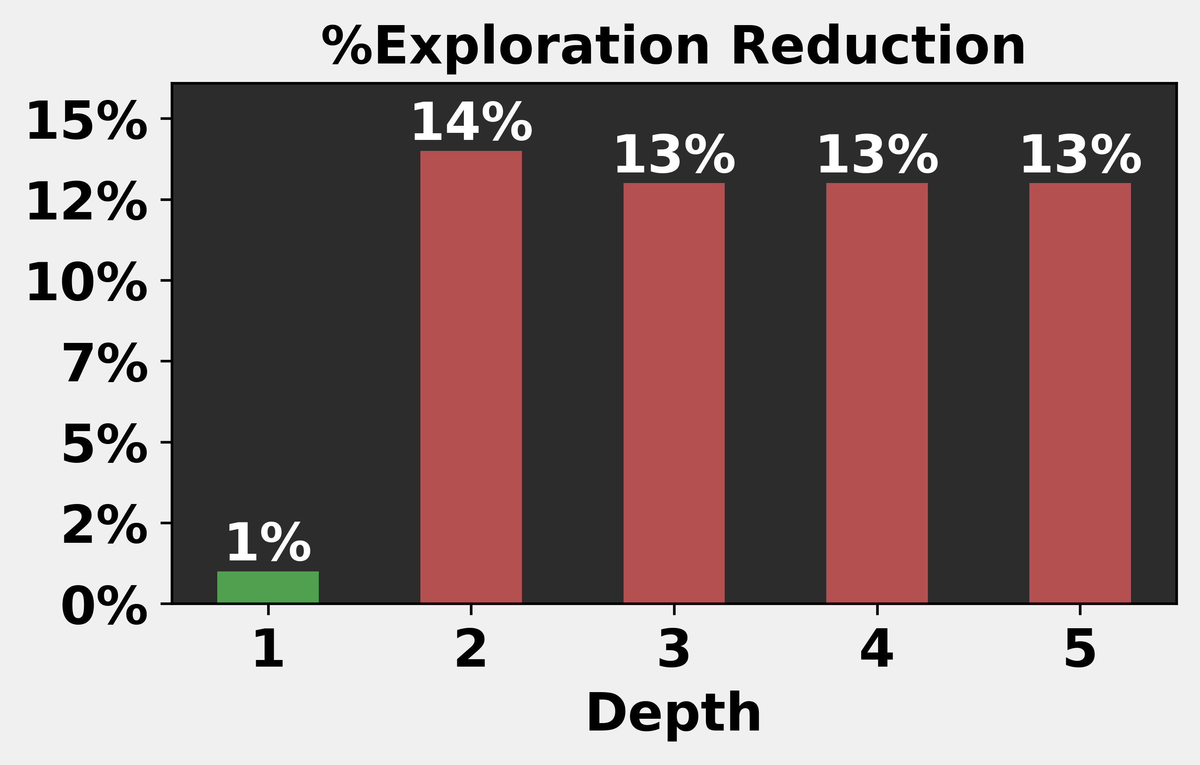
Exploration Reduction by Depth
Depth 1: Minor reduction in explored nodes (1%).
Depth 2: Significant reduction (14%).
Depth > 2: No further gain.
Conclusion: Depth 2 appears to be the most effective depth for deepening.

Slide 44
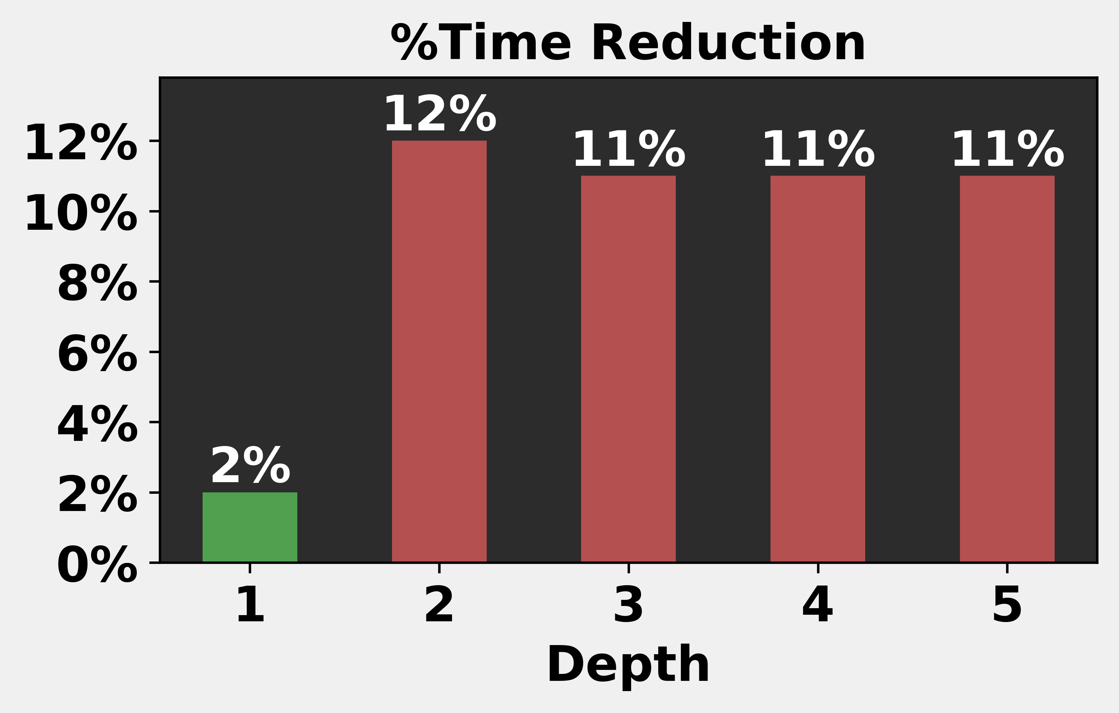
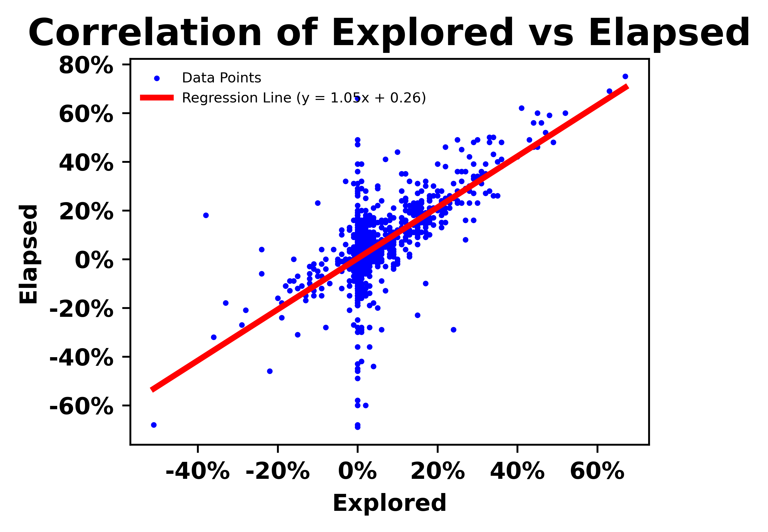
Time Reduction by Depth
Strong correlation between explored nodes and time complexity.
Node exploration is significantly more time-consuming than heuristic lower bounds.
Conclusion: From now on, explored nodes will be our primary performance metric.

Slide 45
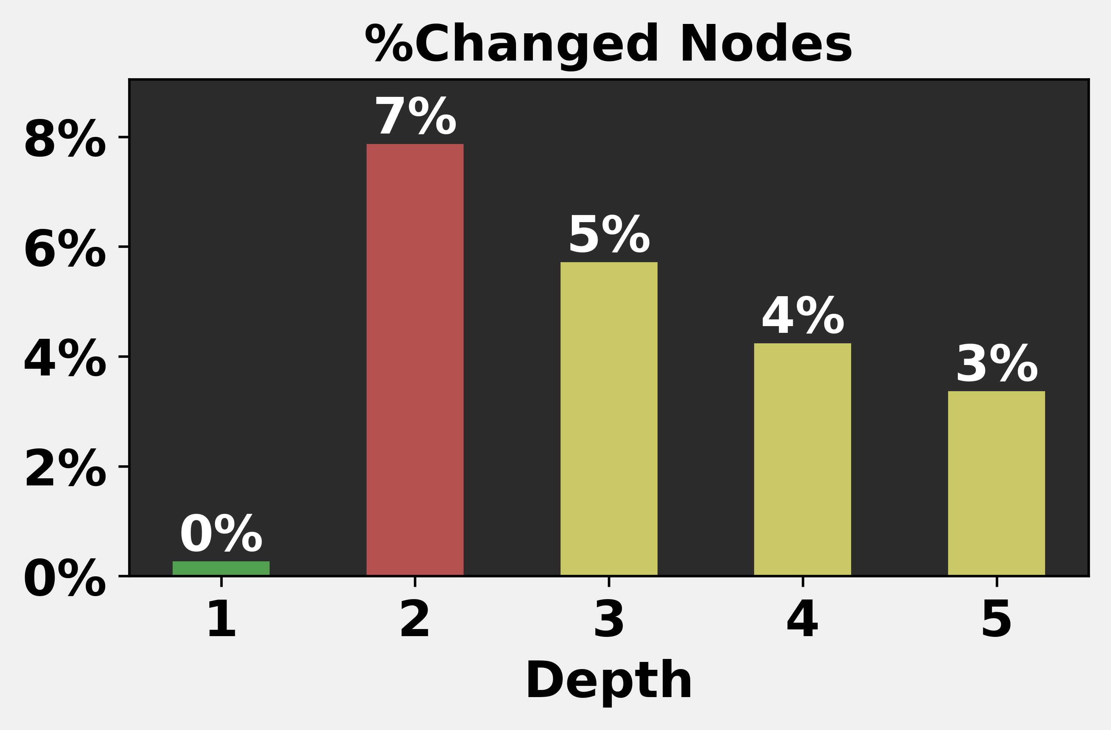
Changed Nodes by Depth (related to all nodes)
Depth 1: Minimal changed nodes (<1%). The optimal path is short relative to the graph, and each optimal node affects at most 2 others.
Depth 2: Noticeable changed nodes (9%). Nodes updated in depth[1] can each influence ~3 more nodes.
Depth > 2: Gradual decline (6%, 5%, 4%). Further depths only narrow the gap between h and h*.
Conclusion: Most changes happen at depth 2. Deeper depths add only minor refinements.

Slide 46
Detailed Statistics for Depth 2

Slide 47
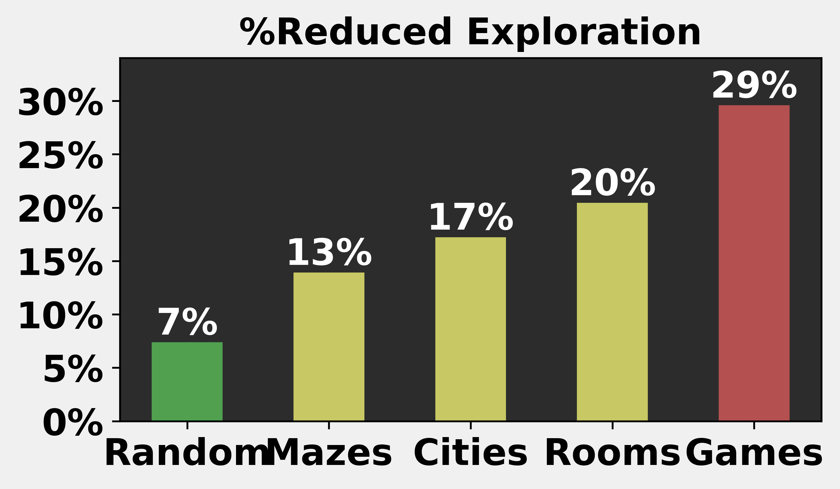
Domain
Best performance in the Games domain.
Worst performance in the Random domain.
Conclusion: Best performance in structured maps and poor in random layouts.

Slide 48
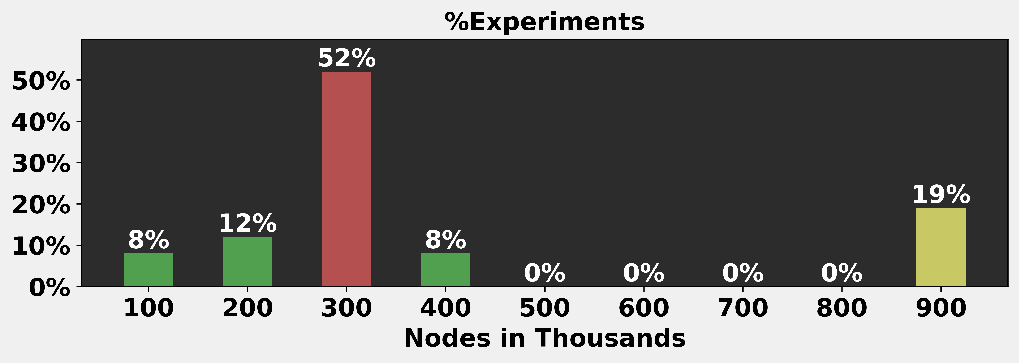
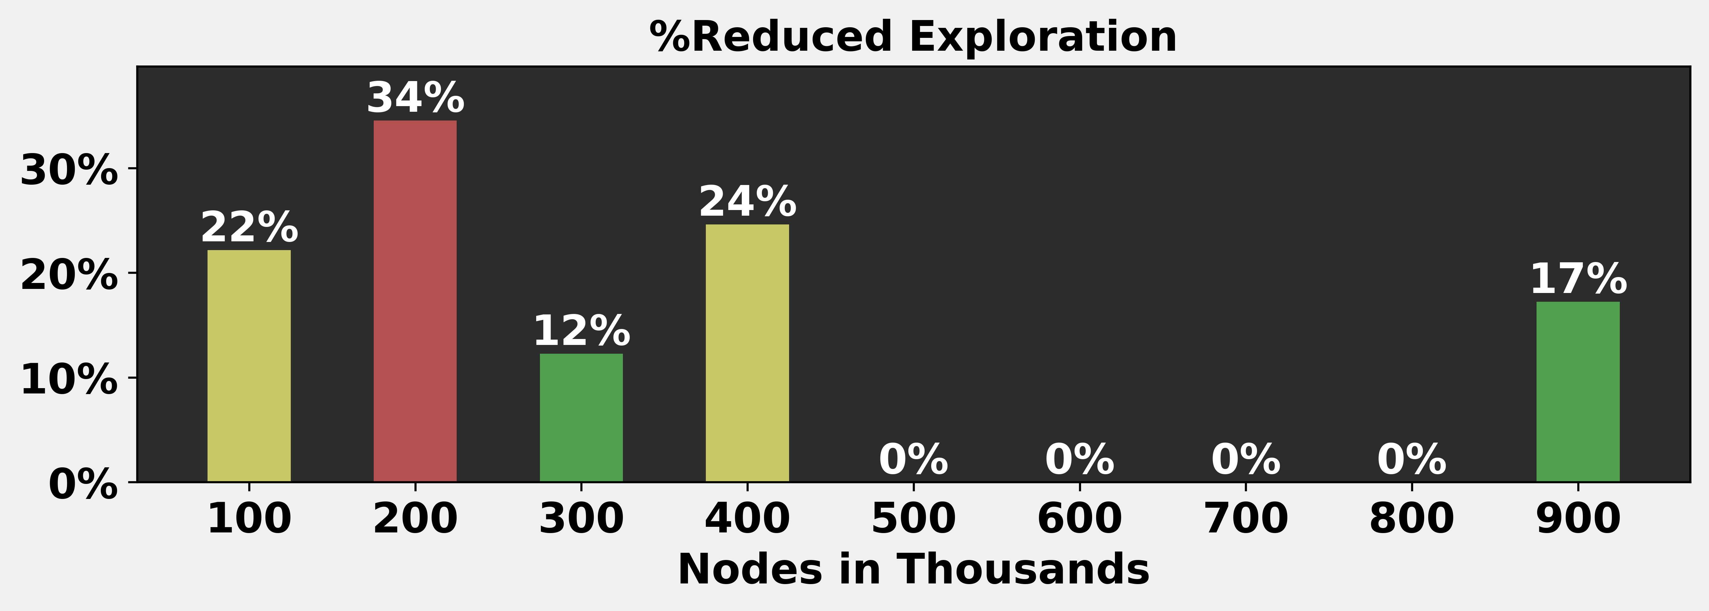
Grid Size
Most grids used in the experiments (72%) have between 200k and 400k reachable nodes.
No significant correlation was observed between grid size and algorithm efficiency.
Conclusion: No strong correlation.

Slide 49
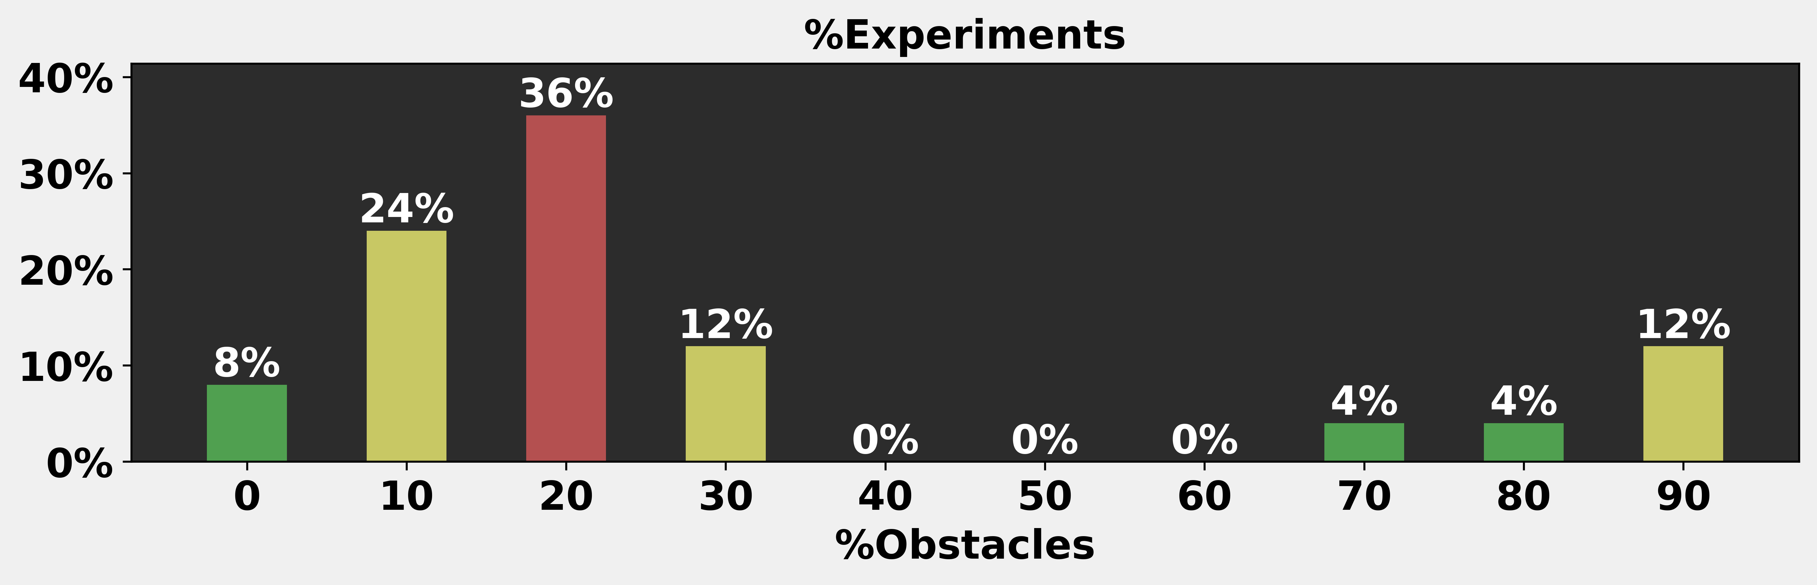
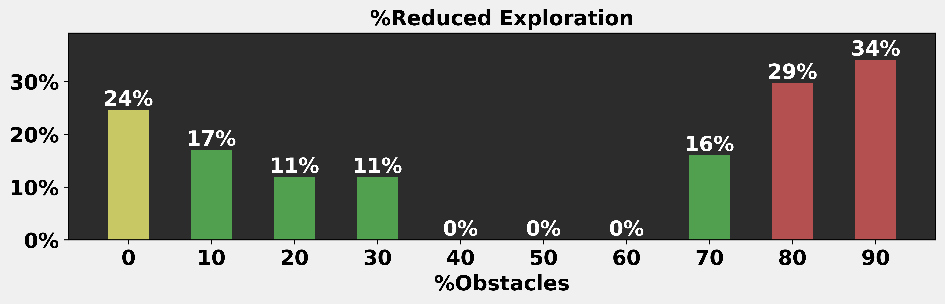
Obstacle-Density
Most grids used in the experiments (80%) have a relatively low obstacle density (<30%).
The best performance was achieved in highly dense grids (>30% reduction at densities >80%).
Conclusion: High density -> High exploration reduction.

Slide 50
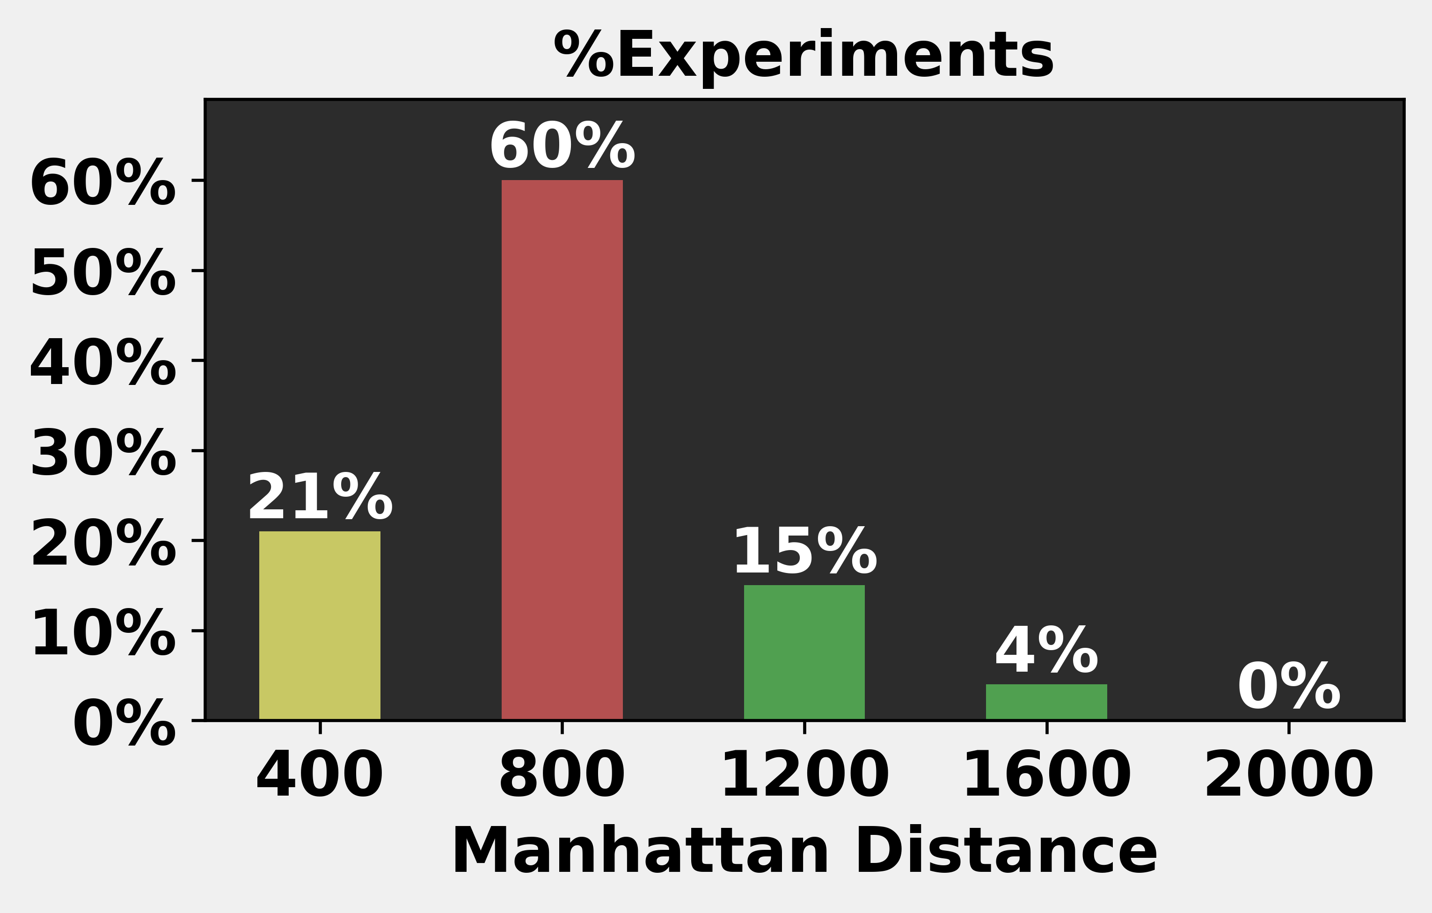
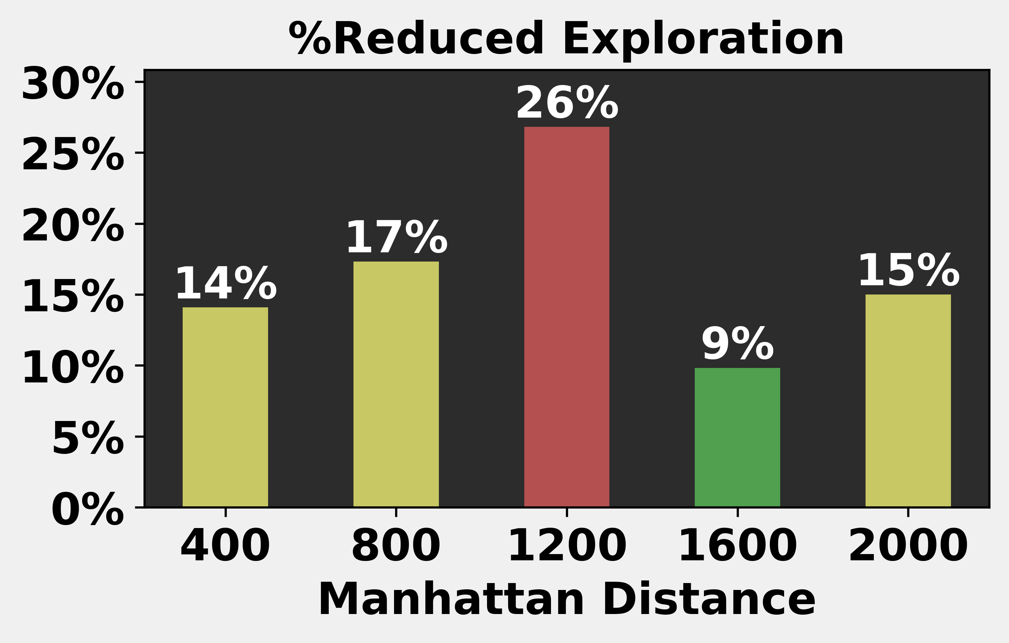
Start-Goal Manhattan-Distance
Most experiments (60%) used medium distances (Manhattan=800).
No significant correlation was observed between start-goal distance and algorithm efficiency.
Conclusion: No strong correlation.

Slide 51
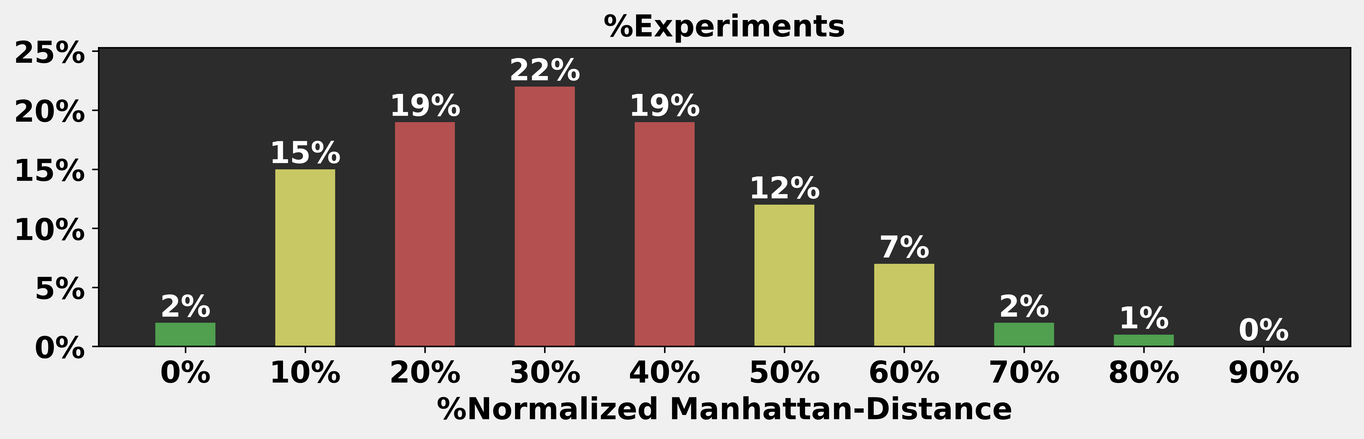
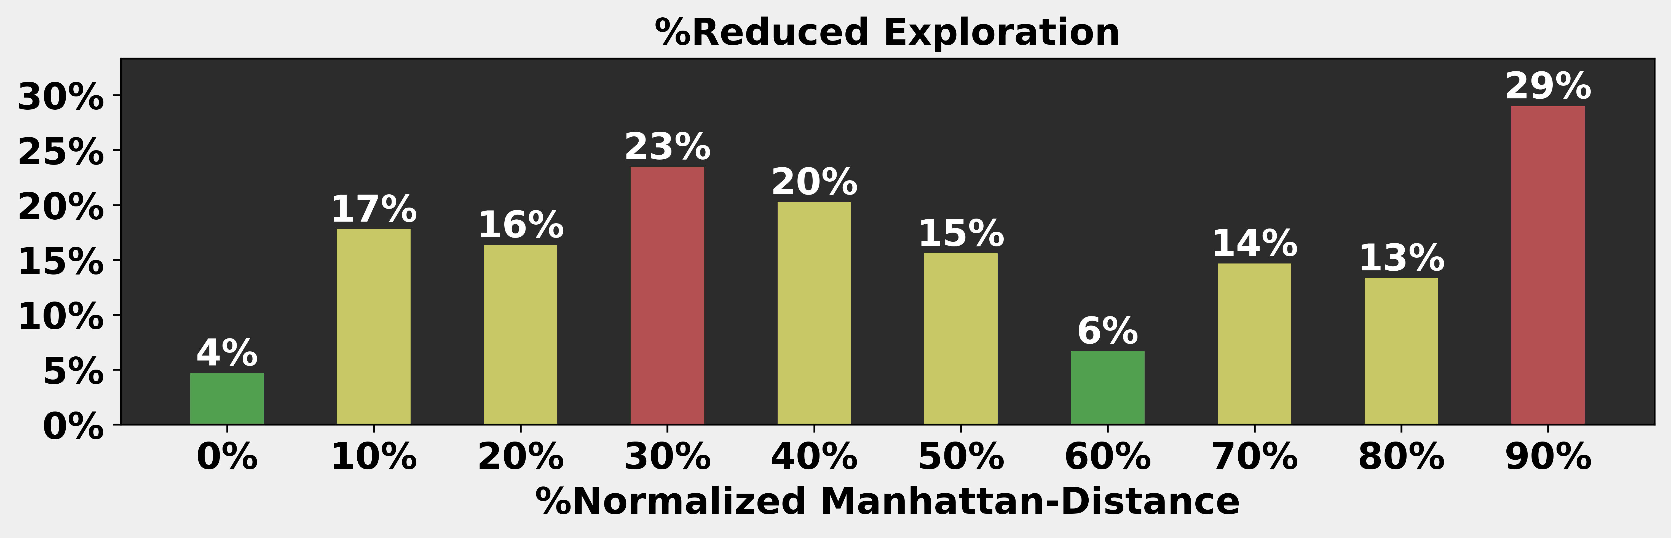
Normalized Manhattan-Distance
Most experiments focused on mid-range distances (20-40%).
The best performance occurred when start and goal were in opposite corners (90% distance), though rarely tested.
Conclusion: Rare corner-to-corner cases delivered the best results.

Slide 52
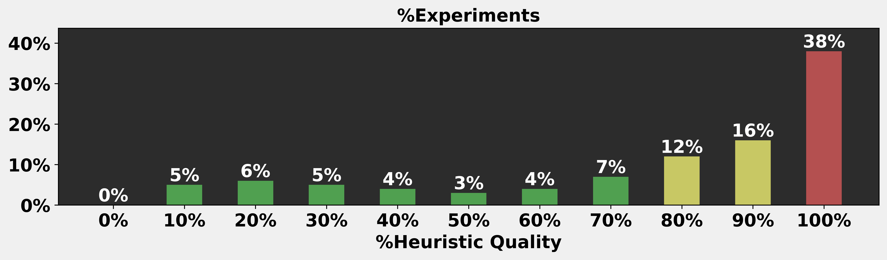
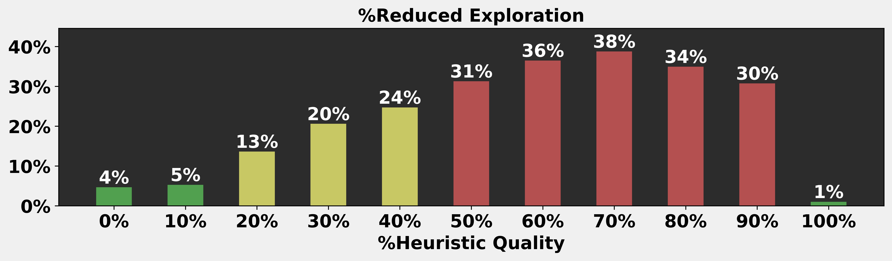
Heuristic-Quality (Heuristic / Real Distance)
Most experiments used high-quality heuristics (>80%).
Peak performance occurred at mid-range heuristic quality (50-90%).
Low performance with near-perfect heuristics.
Conclusion: Best performance on mid-range heuristic quality.

Slide 53
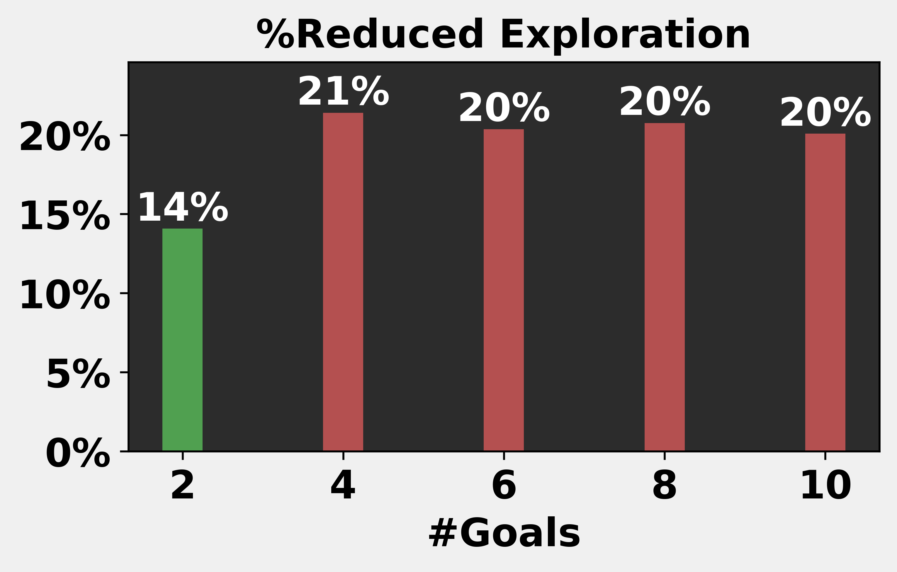
Number of Goals
Going from 2 to 4 goals yields a significant improvement (14% → 21% reduction in exploration).
From 4 to 10 goals, the benefit plateaus (stabilizing around 20-21%).
Conclusion: Best performance on #Goals >= 4

Slide 54
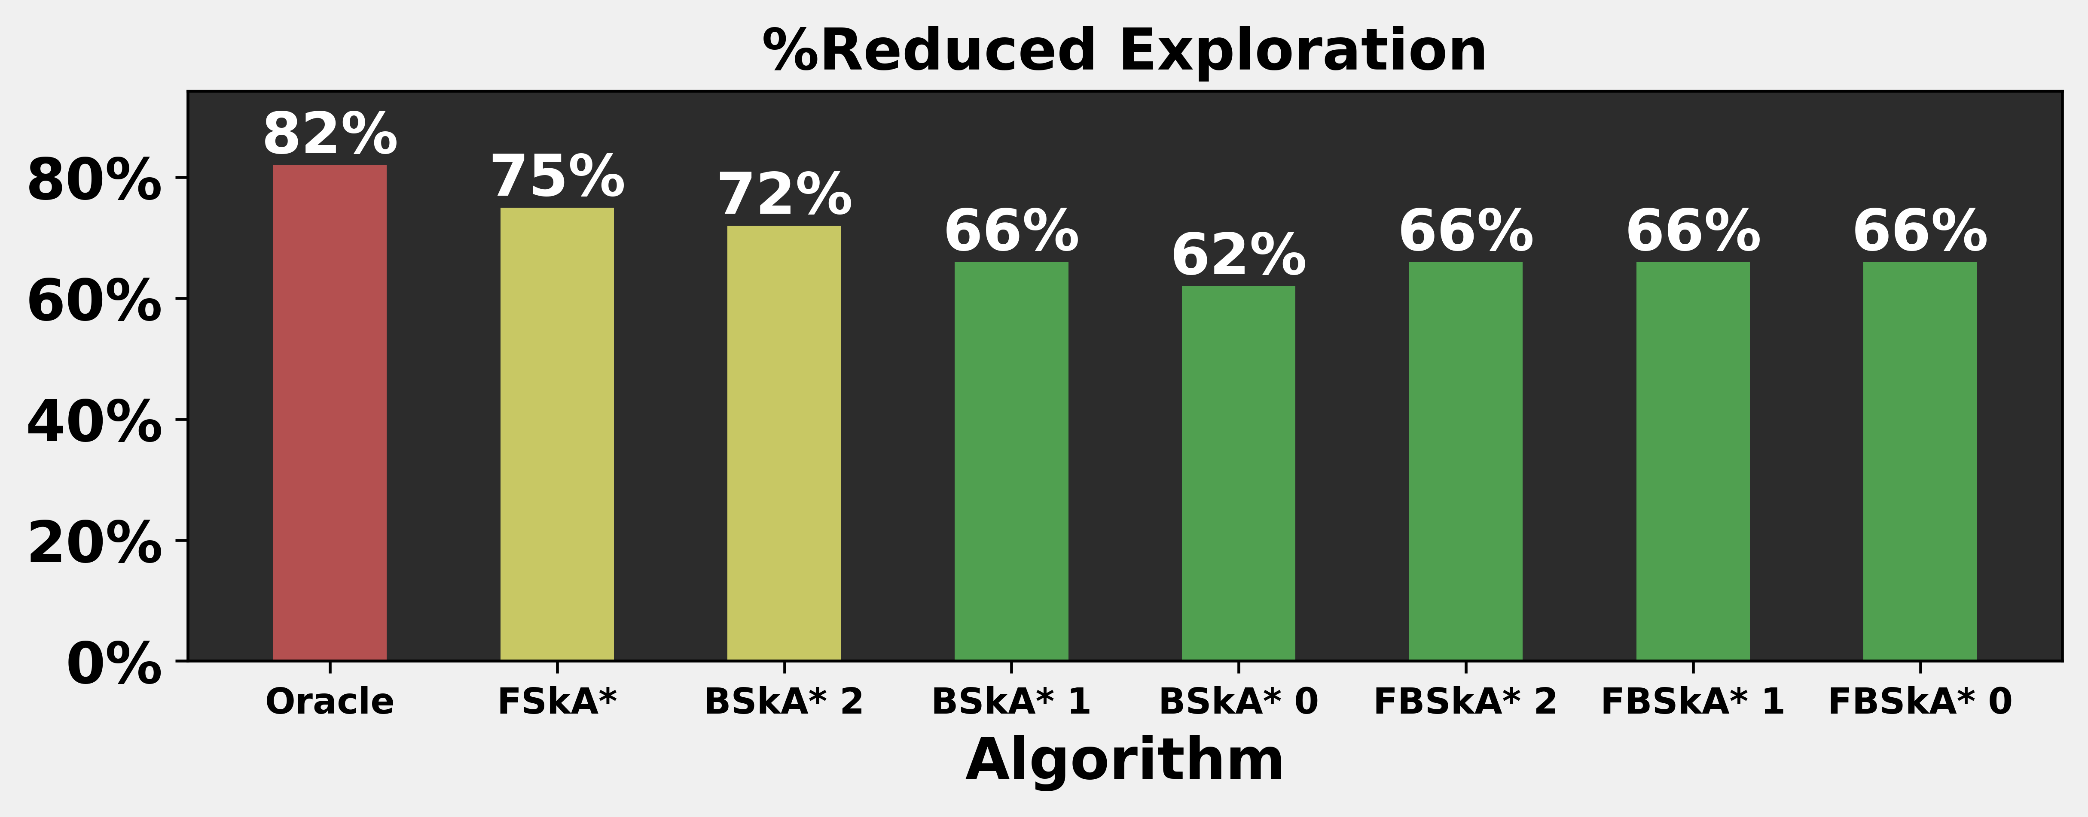
Algorithms (related to kxA*)
BSkA* was the worst algorithm.
But with depth 2, it outperforms FBSkA* and slightly trails FSkA*
Conclusion: Depth 2 significantly boosts BSkA* performance.

Slide 55
Conclusions:

Slide 56
Depth 2 significantly boosts BSkA* performance:
Best Performance in: (1) Structured domains (Games, Rooms). (2) Grids with high obstacle-density (>80%). (3) Corner-to-Corner start and goal locations. (4) Mid-Range heuristic-quality (50-90%) (5) #Goals >= 4
Worst Performance in: (1) Random map layouts. (2) Relatively short distances from start to goals (<20%). (3) Sparse grids. (4) Perfect heuristic (~100%) or very poor heuristics (<10%). (5) #Goals = 2

Slide 57
The END

